Slide 1
CS210
Algorithms and Data Structures
Hash Tables
Week 8
Semester 1 2025
Dr. Pierpaolo Dondio

Slide 2
Week 7
Hash Function, Index and Tables: definition and functioning
Closed Addressing Hash Table
Open address Hash Table
Dynamic Hashing
Built-in Java classes
Examples in Java

Slide 3
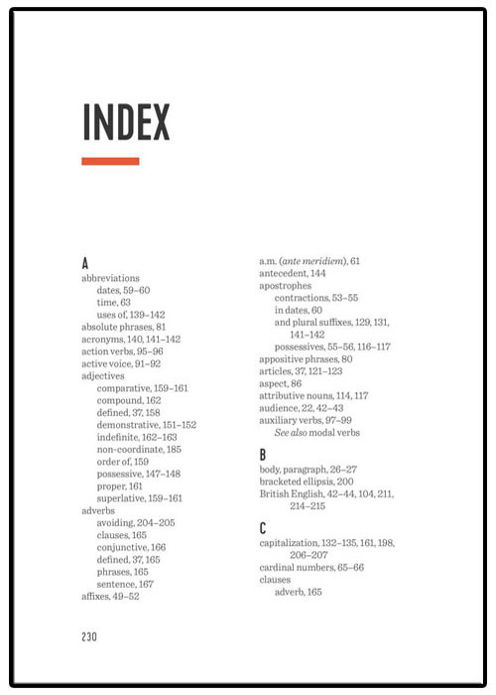
What is an index
An additional data structure used to access data in a more efficient way
It contains “keys” that are the location to access the associated value
The index is small and kept sorted
The values can be in a large unsorted data structure
In order to access a value, first we access the index, we get the key, and we access the value/data we were looking for
Therefore, we need to perform two accesses, one for the index, one for the actual data we are searching

Slide 4
What is an index /2
An index can be implemented as a 2D array
For each key, it stores the location of a chuck of data
Index and Data can be two different files, or two tables in a database. It is an abstract data structure
Data
Index
ST ID | Fname | Lname | age | Address | Tel
351 | John | Fsdfsdf | 32 | S fsfas f ds fa | 1234
2221 | Mary | Dsgds | 21 | Saf dsaf ds f | 35345
484 | Bob | Dfgdfs | 22 | fdsaf | 6445
101 | Carol | Ggdgs | 21 | gd gsd | 2423
510 | Sean | dsgds | 19 | sd gds | 654645
ST ID (key) | Location
101 | 3
221 | 1
351 | 0
484 | 2
510 | 4

Slide 5
Complexity of searching by Index
If the index is sorted, we can perform a binary search
O(log n)
Once the index is found, we can access the data file directly
O(1)
In total, complexity is O(log n)
Without an index, linear search O(n)

Slide 6
Hash Table
A hash table is a data structure that implements an associative array, also called a dictionary or simply map;
An associative array is an index, it is an abstract data type that maps keys to values.
A hash table uses a hash function to compute an index, also called a hash code, into an array of buckets or slots, from which the desired value can be found.
On average, it can reduce the time to access a data item to O(1), while the worst case is O(n)
The more data are inserted, the higher is the chance that the hash table index will degenerate towards a linear sarch (worst case)

Slide 7
Hash Function
Hash table are based on the notion of Hash Function H(x)
H(x) transforms (map) the input value into a pre-defined range of values that are used to build an index to access the data
Example:
H(X) = “last digit of a number” [x mod 10]
Data
ST. ID
ST ID | Fname | Lname | age | Address | Tel
120 | John | Fsdfsdf | 32 | S fsfas f ds | 1234
351 | Mary | Dsgds | 21 | Saf dsaf ds | 35345
482 | Bob | Dfgdfs | 22 | fdsaf | 6445
103 | Carol | Ggdgs | 21 | gd gsd | 2423
514 | Sean | dsgds | 19 | sd gds | 65464
482
H(x)
2
120
H(x)
0

Slide 8
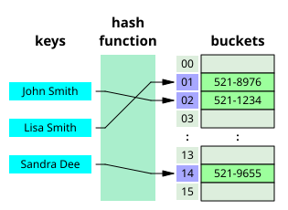
Hash Table Terminology
In a Hash Table the input to the hash function is called a “key”, the hash function will map the key into a “hashed” value that is the location of a “bucket”, the place where the data are stored
The keys can be anything, numbers , strings, objects… the hash function will map them into indexes to be used to access the right bucket
Time complexity. After the hash function is computed in constant time O(1), we can access the right bucket containing the right data in O(1)
All fine, until collisions start to happen!

Slide 9
Collisions
What if the function H(x) returns the same value for 2 different keys?
482
H(x)
2
762
H(x)
2
What data is at position 2? The data about the key 482 or 762?
At the start the Hash Table is empty. If we insert 482 first, 482 goes to the position 2. Then, when we insert 762, it should also go to position 2, but it is already taken. We need to handle this situation…
This is called a collisions and the Hash Table needs a way to handle collisions
Load factor = number in the hash table / size of the hash table (% of hash table positions used)

Slide 10
Some ideas
First, we should try to avoid collisions or minimize them
Solution: the hash function H(x) should only return unique values
Not possible in practice!
The input space is much larger than the output of the hash function
Example: we want to create a hash table to store information about students, each student is represented by a 10 character string
There are 141 trillions combinations!
Our data table is much smaller, collisions are inevitable
Second solution: H(x) should minimize the collisions by spreading the input values equally
Example:
Input: a string s of 5 characters, 128 buckets available
H1(x) = ASCII(s[0]) mod 128
H2(x) = for c in s: {h = (h * 31 + ord(c)) % 128}

Slide 11
Some ideas
H1(x) = ASCII(s[0]) mod 128
H2(x) = for c in s: {h = (h * 31 + ord(c)) mod 128}
All the names starting with the same letter go to the same bucket.
Like “apple” or “ant” or “all” goes to the same bucket
Since the initial letter is not uniformly distributed, some buckets will have a lot of collisions, some other will be under used.
We want H(x) to distribute the values in the most uniform way we can
H2(x) is more complex but it is more random and names are spread more uniformly over buckets.

Slide 12
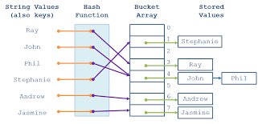
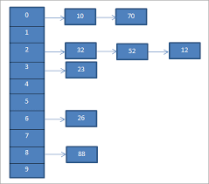
How to Handle Collisions / Chaining
Bucket can store more than 1 data value
A bucket is usually a dynamic array or a list. (in memory) or a block of data (on disk)
When there is a collision, the element is added to the list of elements for that bucket
Using the Hash function, I can get the position of a bucket and then I do linear search inside each bucket list, that should be small enough to keep good performance
If a bucket is full due to too many collisions and they have fixed size, we could use overflow buckets

Slide 13
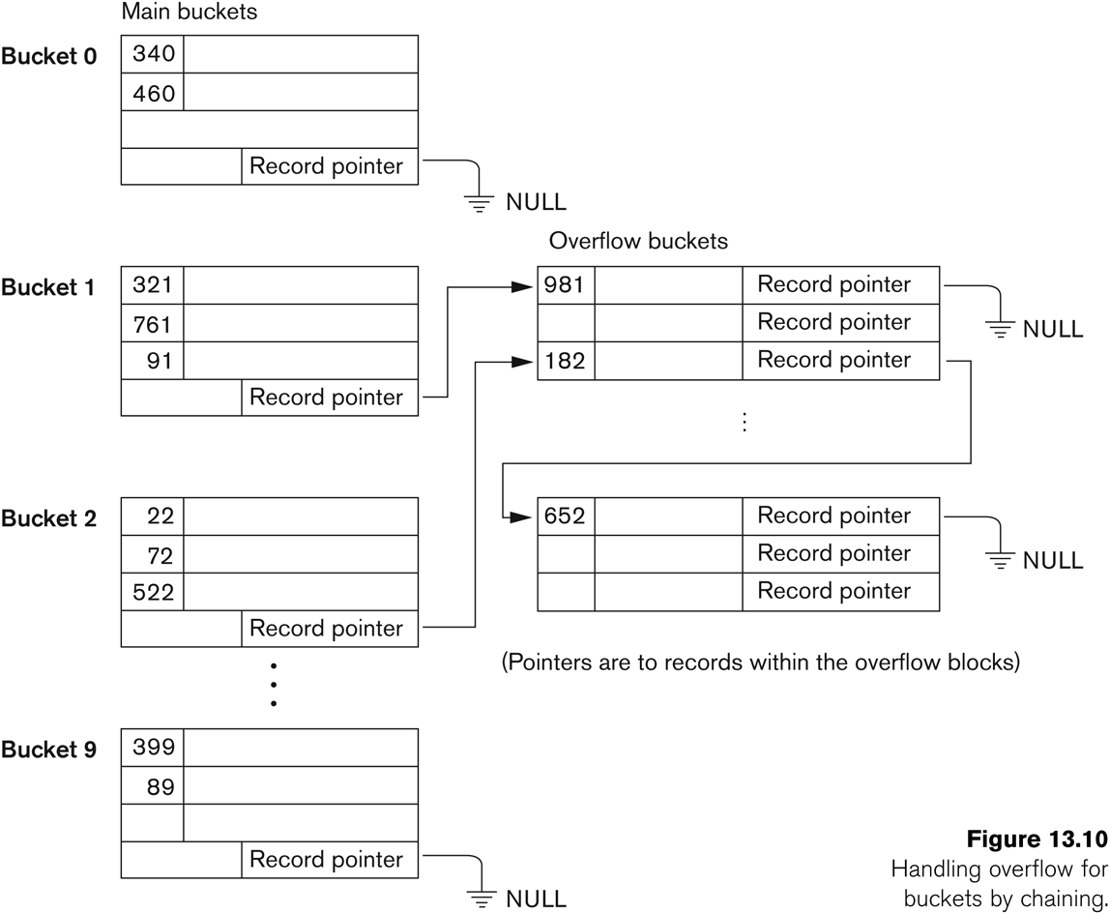
Collisions / Chaining and Overflow
If a bucket is full due to too many collisions and they have fixed size, we could use overflow buckets, common to all the buckets

Slide 14
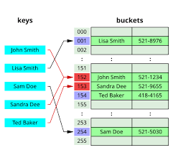
How to Handle Collisions / Open Addressing
Buckets store exactly 1 value
If there is a collision
If a collision happens, the algorithm probes (searches) for another empty bucket according to a rule.
Let’s assume the size of the hash table is size
Main three strategies:
  Linear probing: check next slots → (index + n) % size for n=1….size
  Quadratic probing: check (index + n²), (index + n²), for n=1….size
  Double hashing: use a second hash function for the step size.

Slide 15
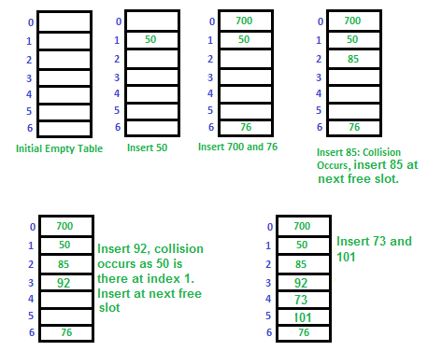
Linear Probing
Linear probing is a method to resolve collisions in a hash table using open addressing.
When a key hashes to a bucket that is already occupied, linear probing searches for the next available bucket in a sequential manner.
Typically, the next bucket is checked by adding 1 each time.
Formula: Index = (h+i) mod capacity
Pros: simple, memory-efficient
Cons: primary clustering of consecutive slots, sensitive to high load factor
Complexity: O(1) with no collisions, gradually becoming O(n) with high number of collisions
Index = (h+i) mod capacity,
i=0,1,…

Slide 16
Quadratic Probing
Quadratic probing is an open addressing collision resolution technique.
When a collision occurs, instead of checking the next sequential slot (like linear probing), it checks slots at a quadratic distance from the original hash.
Formula: Index = (h+i^2) mod capacity
Pros: still simple, avoid big primary sequential clusters
Cons: clusters are still possible (they are called secondary clusters), no guarantee to find a place in the table
Complexity: O(1) with no collisions, gradually becoming O(n) with high number of collisions
$$index=\left(h+i^{2}\right) mod capacity, i=0,1,…$$
Index | Value
0 | 17
1 | 8
2 | -
3 | 3
4 | -
5 | -
6 | -
Index | Value
0 | 17
1 | 8
2 | -
3 | 3
4 | 14
5 | -
6 | -
Add 14
14 mod 7 = 0 (Bucket 0 occupied)
Try bucket (0+1^2) = 1 (Bucket 1 occupied)
Try bucket (0+2^2) = 4 Buket 4 Free)
Insert 14 into bucket 4

Slide 17
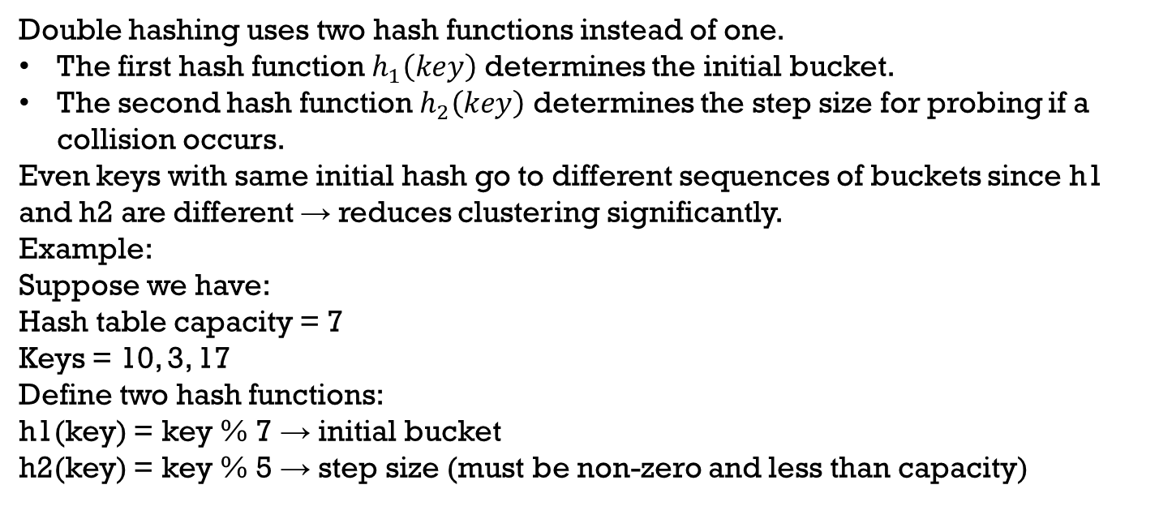
Double Hashing
$$index=\left(h_{1}\left(x\right)+i∗h_{2}\left(x\right)\right)mod size, i=0,1,…$$
Double hashing uses two hash functions instead of one.
The first hash function $h_{1}\left(key\right)$ determines the initial bucket.
The second hash function $h_{2}\left(key\right)$ determines the step size for probing if a collision occurs.
Even keys with same initial hash go to different sequences of buckets since h1 and h2 are different → reduces clustering significantly.
Example:
Suppose we have:
Hash table capacity = 7
Keys = 10, 3, 17
Define two hash functions:
h1(key) = key % 7 → initial bucket
h2(key) = key % 5 → step size (must be non-zero and less than capacity)

Slide 18
Double Hashing
H1(x) = x mod 9
H2(x) = x mod 5
H1+ i*H2
Index | Value
0 | 17
1 | 8
2 | -
3 | 3
4 | -
5 | 34
6 | -
7
8
Index | Value
0 | 17
1 | 8
2 | -
3 | 3
4 | -
5 | 34
6 | -
7
8
Add 14
14 mod 9 + 0 * 14 mod 5 = 5 (bucket 5 occupied)
Try bucket = (14 mod 9 + 1*14 mod 5 ) mod 9 = 14 mod 9 = 5 (bucket 5 occupied)
Try bucket = (14 mod 9 + 2*14 mod 5 ) mod 9 = 8 mod 9 = 8 (bucket 8 free)

Slide 19
Double Hashing
H1(x) = x mod 9
H2(x) = x mod 5
H1+ i*H2
Index | Value
0 | 17
1 | 8
2 | -
3 | 3
4 | -
5 | 34
6 | -
7
8
Index | Value
0 | 17
1 | 8
2 | -
3 | 3
4 | -
5 | 34
6 | -
7
8 | 14
Add 14
14 mod 9 + 0 * 14 mod 5 = 5 (bucket 5 occupied)
Try bucket = (14 mod 9 + 1*14 mod 5 ) mod 9 = 14 mod 9 = 5 (bucket 5 occupied)
Try bucket = (14 mod 9 + 2*14 mod 5 ) mod 9 = 8 mod 9 = 8 (bucket 8 free)

Slide 20
Comparison
All the techniques start with a search complexity of O(1) and they degenerate to linear search O(n) when the load factor starts to grow
However, they degenerate “at different speed”. Linear probing is the easier to implement, but the first to degenerate.. Chaining is more complex (it requires also more memory to build the index and access the data) but it is more robust to high load factor
Load Factor (α) | Linear Probing | Quadratic Probing | Double Hashing | Chaining
0.1 – 0.5 | Excellent O(1) | Excellent O(1) | Excellent O(1) | Excellent O(1)
0.6 – 0.8 | Degrades (clustering) | Good | Very Good | Still Good
0.8 – 1.0 | Poor | Fair | Still OK | Good (slower but stable)
> 1.0 | Not possible (open addressing must resize) | Not possible | Not possible | Still works (chains just grow)

Slide 21
Dynamic And Extendible Hashing
Dynamic and Extendible Hashing Techniques
  Hashing techniques are adapted to allow the dynamic growth and shrinking of the number of file records.
Dynamic hashing use the binary representation of the hash value h(K) in order to access a directory.
  In extendible hashing the directory is an array of size 2^{d} where d is called the global depth.

Slide 22
Dynamic And Extendible Hashing
The directories can be stored on disk, and they expand or shrink dynamically.
  Directory entries point to the disk blocks that contain the stored records.
An insertion in a disk block that is full causes the block to split into two blocks and the records are redistributed among the two blocks.
  The directory is updated appropriately.
The directories can be stored on disk, and they expand or shrink dynamically.
  Directory entries point to the disk blocks that contain the stored records.
An insertion in a disk block that is full causes the block to split into two blocks and the records are redistributed among the two blocks.
  The directory is updated appropriately.

Slide 23
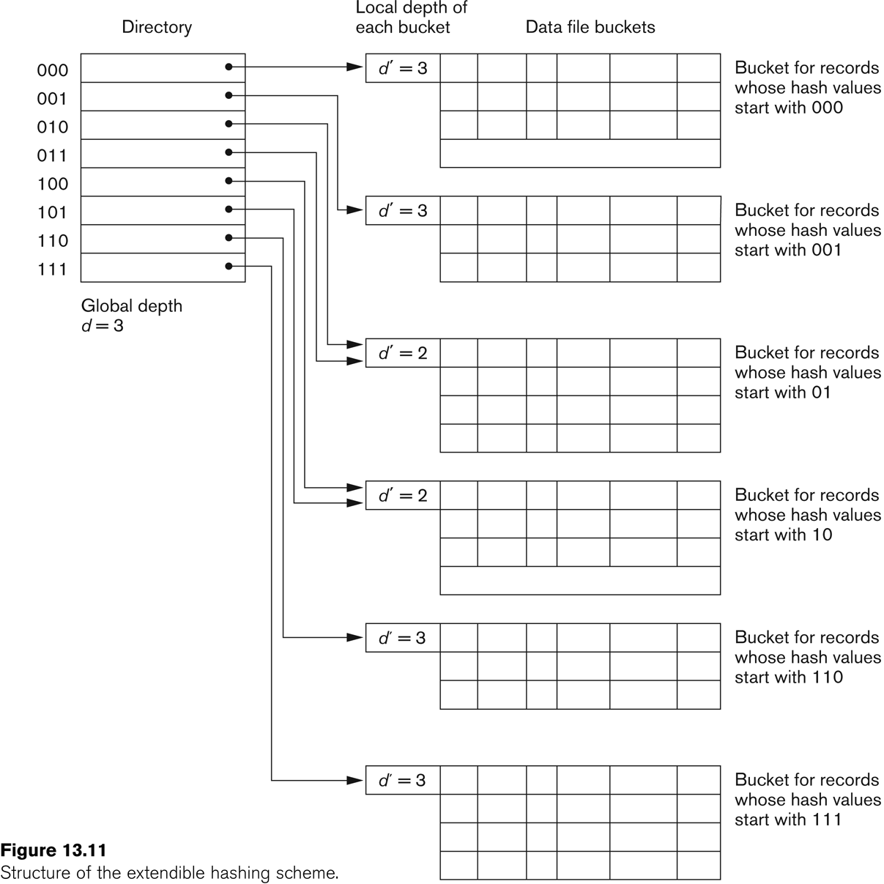
Extendible Hashing
Key structure:
A directory: array of pointers to buckets.
Each bucket: holds a few key-value pairs and a local depth.
Global depth: number of hash bits used to index the directory.
Expansion rule:
When a bucket overflows, it splits.
If the bucket’s local depth becomes larger than the global depth → double the directory size (expand).

Slide 24
Dynamic Hashing
00 | -
00 | -
482
H(x)
1000101
01 | -
01 | -
Let’s assume
Bucket size = 2
At the beginning, only the first 2 bits are used to compute the bucket location. Therefore 4 buckets are indexed at the start (2^2)
The hash function returns 7 bits (global depth = 2^7 = 128), a max of 128 buckets can be supported. In real systems, it can go up to 32 bits or more.
10 | -
10 | -
11 | -
11 | -

Slide 25
Dynamic Hashing
00 | -
00 | -
482
H(x)
1000101
01 | -
01 | -
At the beginning, only the first 2 bits are used to compute the bucket location
10 | 482
10 | -
11 | -
11 | -

Slide 26
Dynamic Hashing
00 | -
00 | -
842
H(x)
1000111
01 | -
01 | -
At the beginning, only the first 2 bits are used to compute the bucket location
10 | 482
10
11 | -
11 | -

Slide 27
Dynamic Hashing
00 | -
00 | -
842
H(x)
1000111
01 | -
01 | -
At the beginning, only the first 2 bits are used to compute the bucket location
10 | 482
10 | 842
11 | -
11 | -

Slide 28
Dynamic Hashing
00 | -
00 | -
H(x)
01 | -
01 | -
Bucket 10 is full, double the index and use 1 extra bit from the hash function to identify the bucket
10 | 482
10 | 842
11 | -
11 | -

Slide 29
000 | -
000 | -
Dynamic Hashing
001 | -
001 | -
010 | -
010 | -
H(x)
011 | -
011 | -
100 | 482
100 | 842
Now there are 2^3=8 buckets, and we use 3 bits from the hash function value
101 | -
101 | -
110 | -
110 | -
111 | -
111 | -

Slide 30
000 | -
000 | -
Dynamic Hashing
001 | -
001 | -
010 | -
010 | -
952
H(x)
1010111
011 | -
011 | -
100 | 482
100 | 842
Now 3 bits are used for the hash function, 952 goes to bucket 101
101 | -
101 | -
110 | -
110 | -
111 | -
111 | -

Slide 31
000 | -
000 | -
Dynamic Hashing
001 | -
001 | -
010 | -
010 | -
952
H(x)
1010111
011 | -
011 | -
100 | 482
100 | 842
101 | 952
101 | -
110 | -
110 | -
111 | -
111 | -

Slide 32
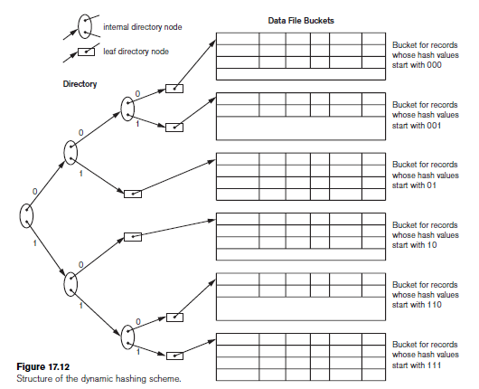
Dynamic Hashing

Slide 33
Exercises
Index | Value
0 | —
1 | 261
2 | 40
3 | -
4 | 900
5 | -
6 | 29
7 | 265
8 | 53
9 | -
10 | 540
11 | -
12 | 638
Consider an Open Addressing Hash Table of size 13 (from 0 to 12), where the hash function uses the mod operator.
Show how the numbers 372, 553 and 651 would be inserted in the above table using linear probing
Show how the numbers 372, 553, 651 would be inserted in the above table using quadratic probing

Slide 34
Java Classes
HashMap class
See HashMapDemo.java on Moodle for a demo
Features
  Hash Function is the hashcode() function built in in java
  Hascode() produces an integer (int) that represents the input object.
  In a hash table, this integer is used to compute the bucket index
  Example: “hello”.hashcode() → 99162322
  Formula for strings:
  Starting capacity (number of buckets) = 16. Given the hashcode, the bucket will be found with the formula H(x) mod capacity
  It is an Hash Table with chaining
  Dynamic hashing used if load factor > 0.75. The capacity is doubled.

Slide 35
Java Classes
HashMap class Methods
Constructor:
HashMap<String, Integer> map = new HashMap<>(size);
put(key,value) = insert a key/value pair in the hash table: map.put("apple", 5)
get(key) = return the value for a specific key: map.get("apple")
map.containsKey(key) = check if a key is in the map map.containsKey("cherry")
map.containsValue(value) = check if a value is in the map Ex: map.containsKey(10)
map.remove("banana") = remove an entry from the Hash table
Loop over the elements:
for (Map.Entry<String, Integer> entry : map.entrySet()) {
System.out.println("Key:" + entry.getKey() +",Value:" + entry.getValue());
}

